Slide 1
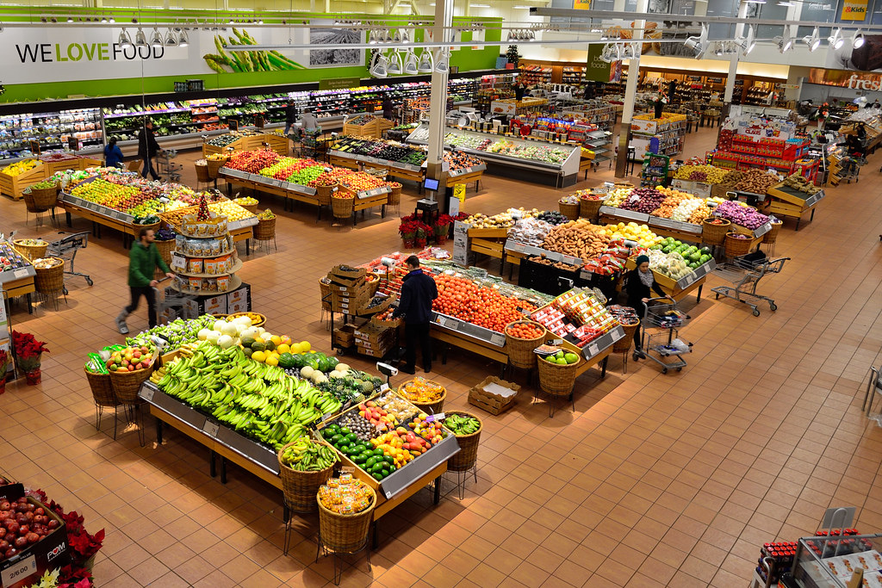

This Photo by Unknown Author is licensed under CC BY-SA

Slide 2
Super Market Billing System

Slide 3
OBJECTIVES OF THE PROJECT :
It is Design to streamline and Enhance the checkout the process, improve accuracy and provide valuable insights for management.
Here we can see the customer list and billing process of their products
We can see here how the sales is going on .
We can observe the different categories of the products
The Dataset contain information about the Customers, Categories, Products, Sales, Sale items, And Discounts
By analyzing this data we aim to uncover and insights that can be improve business operations and decision making.

Slide 4
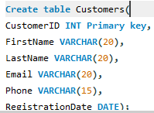
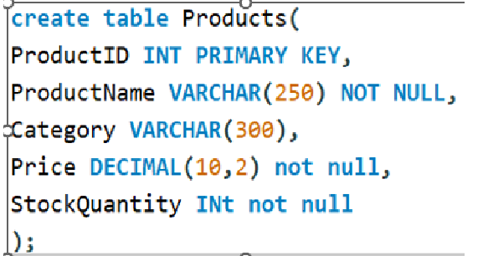
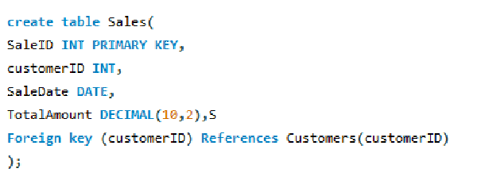

Creating the tables

Slide 5
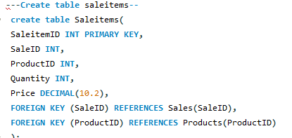
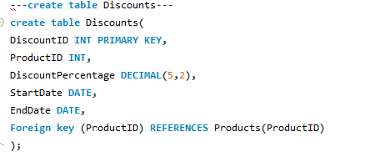

Slide 6
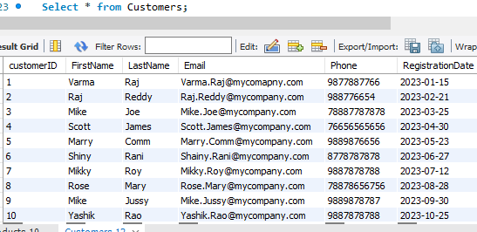
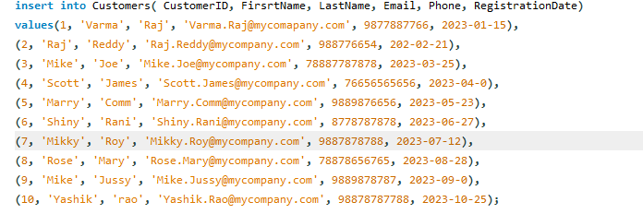
Inserting values into table
Customers
Notes:
Here I inserted the 10 values of customers with the names of columnID, FirstName, LastName, Email, Phone, RegistrationDate and here are the values which I inserted in Customers Table

Slide 7
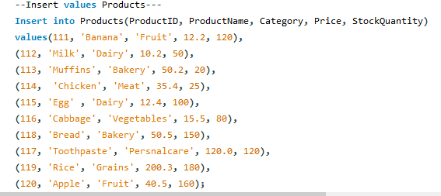
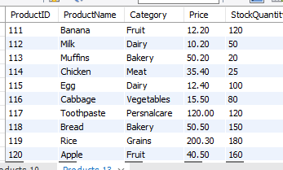
Products
Notes:
Here I showed the Product values and Names with columns ProductID, ProductName, Category, Price, And StockQuantiy and here are the values which I inserted in the Product table

Slide 8
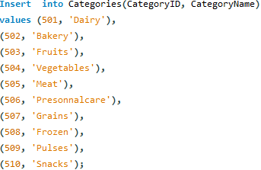
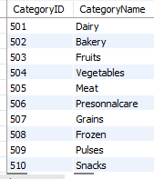
Categories
Notes:
Here I showed inserting values into catrgories with named columned CategoryID, CategoryName and Here are the Values which I inserted in the Category table

Slide 9
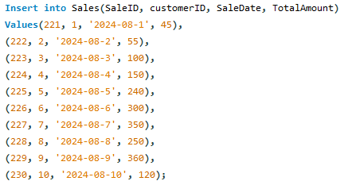
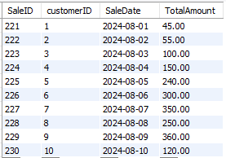
Sales
Notes:
In sales table I named columns with SaleID, CustomerID, SaleDate, Totalamount,And here are the values which I inserted in the Sales Table

Slide 10
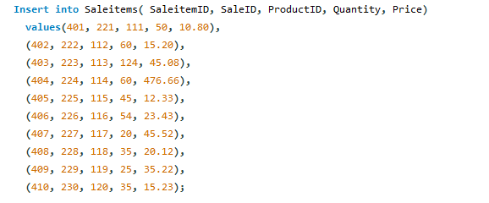
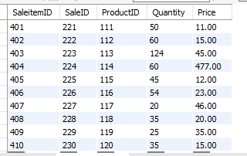
Saleitems
Notes:
In saleitems table I showed the columns named with SaleItemID, SaleID, ProductID, Quantity, Price and here are the values which I inserted here

Slide 11
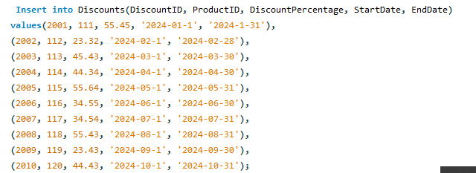
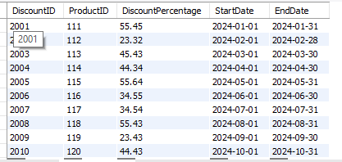
Discounts
Notes:
Here I showed the Discounts columns Named with DiscountID, ProductID, Discuntpercentage, StartDate, EndDate and these are the values which I inserted here

Slide 12
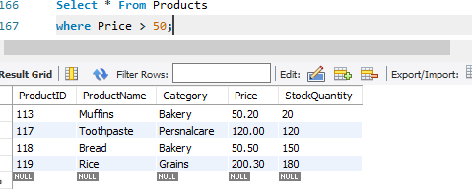
3.Write a query to select all products from the Products table where the Price is greater than $50.
Notes:
Here I selected from products the table and then I selected products which are greater than 50

Slide 13
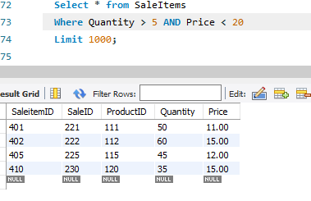
4. Where Clause (AND/OR):
Write a query to select all SaleItems where the Quantity is greater than 5 and the Price is less than $20.
Notes:
Here I used where clause
First we have to select all from Saleitems and here I used where clause to find the values of quantity is >5 and < 20$

Slide 14
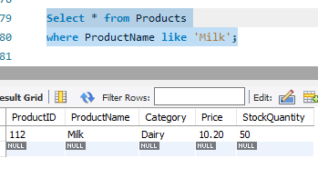
5. LIKE Operator:
Write a query to select all Products where the ProductName contains 'Milk'.
Notes:
Here I showed qery of Products where the Productname contains milk here is the result which shows milk products

Slide 15
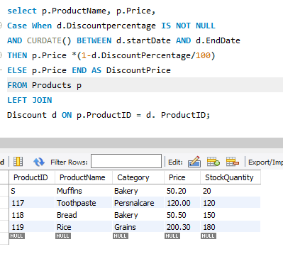
6. CASE Statement:
Write a query to select ProductName, Price, and a new column DiscountedPrice from the Products table. If a product has a discount applicable today, calculate the DiscountedPrice using the discount percentage from the Discounts table.
Notes:
Here I gave Products p ;alias p is used for the Products table, Discount d : alais d is used for Discounts table, CURDATE() is used to check the applicable today by comparing it with the StartDate and enddatein the Discounts table,

Slide 16
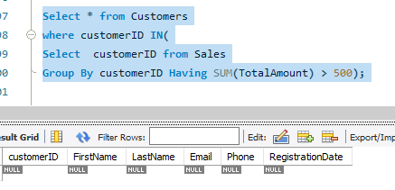
7.Subquery:
Write a query to find all Customers who have made purchases totaling more than $500. Use a subquery to find these CustomerIDs.
Notes:
Here I fined all the customers who have made purchaces total more than 500$ . By using subquery I fined the CustomerID

Slide 17
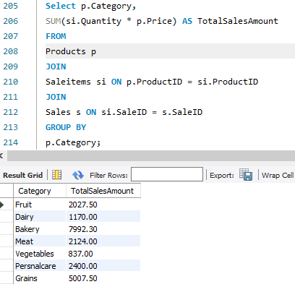
8.Group By:
Write a query to get the total sales amount for each product category. Join Products with SaleItems and Sales, and group by Category.
Notes:
here prodcuts tabled is Aliases as ‘ p’ Saleitem as ‘si ‘, and sales as ‘s’
Join statement is linked with ther products table with saleitems and saleitem with sales
And the sum (si.quantity * price ) calculates the total sales amunt for each product
The group results by category to get the total sales amount per category

Slide 18
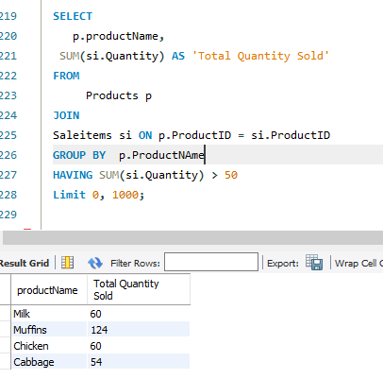
9.Having Clause:
Write a query to get the total quantity sold for each product, but only include products that have been sold more than 50 times. Use the HAVING clause.
Notes:
Products alias ‘p’ , saleitems as ‘si’, join products with saleitem on product id, and group by product name, having Sum (si.quantity) >50 and

Slide 19
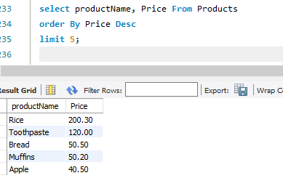
10. Limit:
Write a query to select the top 5 most expensive products.
Notes:
Here I select the top 5 expensive products from Product table and I used order by in desc

Slide 20
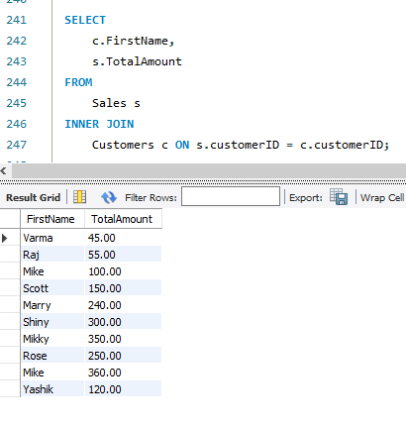
11. Inner Join:
Write a query to join Sales with Customers to get a list of all sales with CustomerName and TotalAmount.
Notes:
Customers alais ‘c’ and Sales alais ‘s’, innerjoin Customers on CustomerID

Slide 21
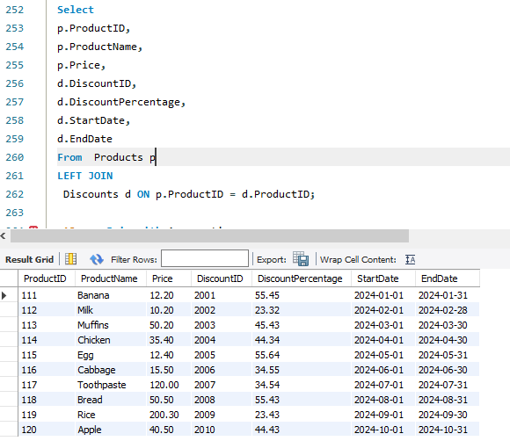
12.Outer Join:
Write a query to get a list of all Products and any associated Discounts. Include products that might not have any discounts.
Notes:
Here I showed the prodcuts alais as p and Disocunts as ‘d’, and left join for Discounts on ProductID

Slide 22
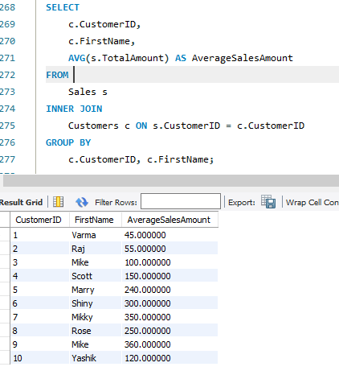
13. Join with Aggregation:
Write a query to get the average sale amount per customer. Use an INNER JOIN between Sales and Customers, and group by CustomerID.
Notes:
Customers alais as ‘c’ and avg for salestotal amount , sales alais as ‘s’, and avg s.saleamunt as averagesalesamount,
From sales,
Innerjoin for customers on sales custmerID and group by customer id Firstname

Slide 23
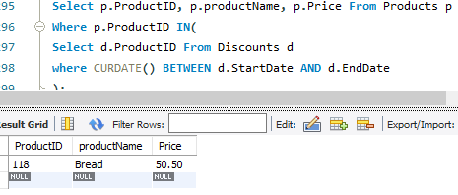
14. Subquery with Join:
Write a query to find all Products that have been sold at a discounted price. Use a subquery to filter products with active discounts.
Notes:
Product alias as ‘p’ ansd Discounts as ‘d’ and here products selected from Discounts ProductID from Discounts subquery used in selected Discounts products of active Discounts

Slide 24
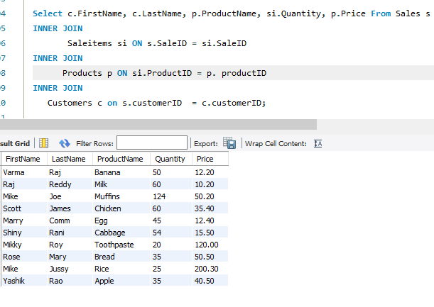
15.Advanced Join:
Write a query to list FirstName, LastName, ProductName, Quantity, and Price for all sales. Use INNER JOIN to link Sales, SaleItems, Products, and Customers.
Notes:
Here showed the list of the customers details and customere alias ‘c’, and saleitem as ‘si’ and product as ‘p’, sales as ‘s’ and used inner join statement for product on productid and advanced inner join of Customers customerID

